Slide 1
Hugging Face Transformers

Slide 2
Hugging Face Transformers is an open-source library designed to make it easy to work with transformer-based machine learning models. It is widely used for natural language processing (NLP) tasks and supports a variety of pre-trained models that can be fine-tuned or used directly for different applications. Here are the key aspects of Hugging Face Transformers:

Slide 3
Key Features:
1. Pre-trained Models:
Access to a wide range of state-of-the-art pre-trained models like BERT, GPT-2, GPT-3, RoBERTa, T5, and many others.
Models are available for various languages and tasks.
2. Ease of Use:
Simple API that allows users to load pre-trained models with just a few lines of code.
High-level abstractions for common NLP tasks like text classification, named entity recognition, question answering, text generation, and translation.

Slide 4
3. Flexibility:
Supports both TensorFlow and PyTorch frameworks.
Easily customizable to fine-tune models on custom datasets.
Integration with other libraries and frameworks for building complex NLP pipelines.
4. Model Hub:
Hugging Face Model Hub hosts thousands of pre-trained models that can be easily searched, downloaded, and used.
Users can also upload their own models to the hub for sharing with the community.

Slide 5
Trainer API:
A powerful API for training and fine-tuning models, simplifying the process of setting up training loops, managing data, and optimizing hyperparameters.
Community and Ecosystem:
Strong community support with extensive documentation, tutorials, and an active forum.
Integration with the Hugging Face Datasets library, which provides a collection of ready-to-use datasets for various NLP tasks.

Slide 6
Common Use Cases:
1. Text Classification:
Sentiment analysis, spam detection, topic classification, etc.
2. Named Entity Recognition (NER):
Identifying entities like names, dates, locations, and more within text.
3. Question Answering:
Building systems that can answer questions based on a given context or document.
4. Text Generation:
Generating human-like text for chatbots, story generation, content creation, etc.
5. Translation:
Translating text between different languages.

Slide 7
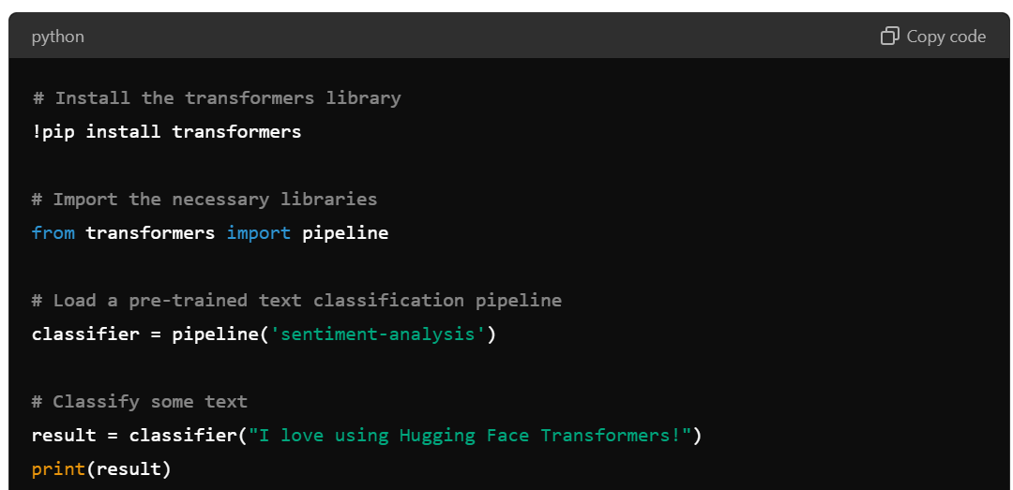
Example Code:
Here's a simple example of how to use Hugging Face Transformers to perform text classification with a pre-trained BERT model:

Slide 8
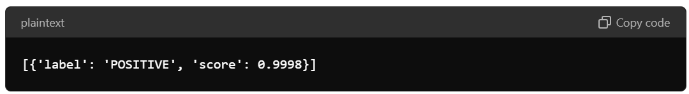
This example demonstrates the simplicity and power of Hugging Face Transformers, allowing users to leverage advanced NLP models with minimal effort.

